Slide 1
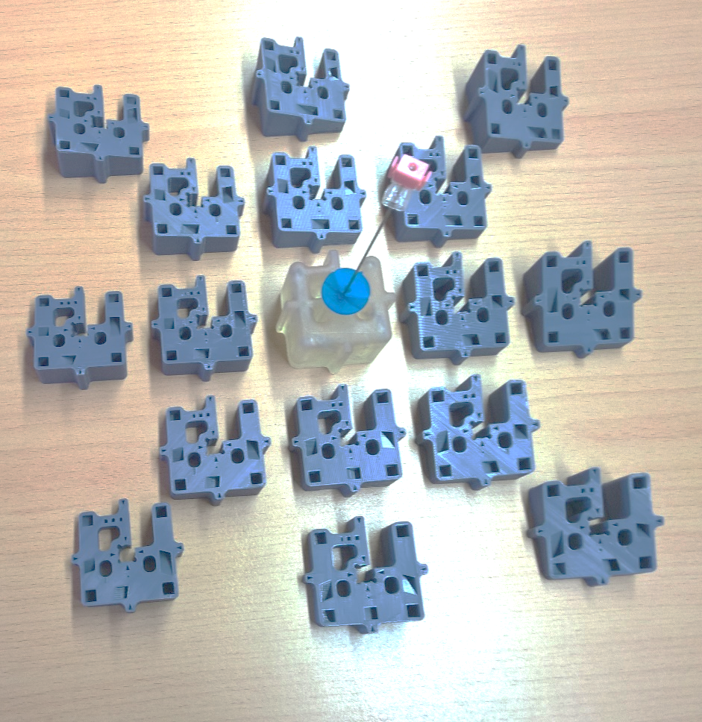
Characterization and automated alignment detection of an additively manufactured Z-frame marker to process signals for robotic control in interventional MRI
Parisa Parsanejad
Medical Systems Engineering
Supervisors:
Prof. Dr. Michael Friebe
M. Sc. Robert Odenbach
Final Presentation
24.10.2018

Slide 2
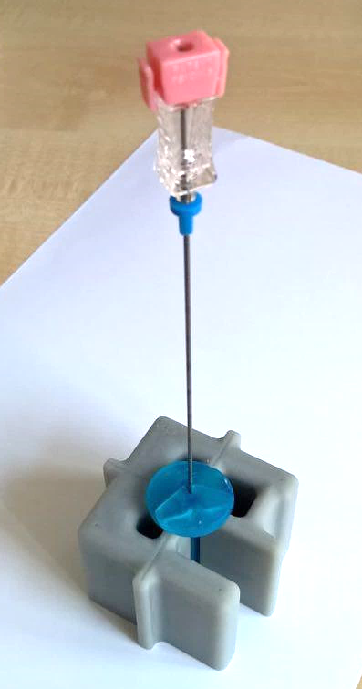
Contents
Introduction
MRI-guided intervention
Additively manufactured Z-frame
Z-frame marker design and characterization
Methodology
Alignment workflow
Navigation workstation
Graphical user interface
Testing and results
Gold standard CAD analysis
Z-frame marker positioning
Phantom targeting test
Conclusion and outlook

Slide 3
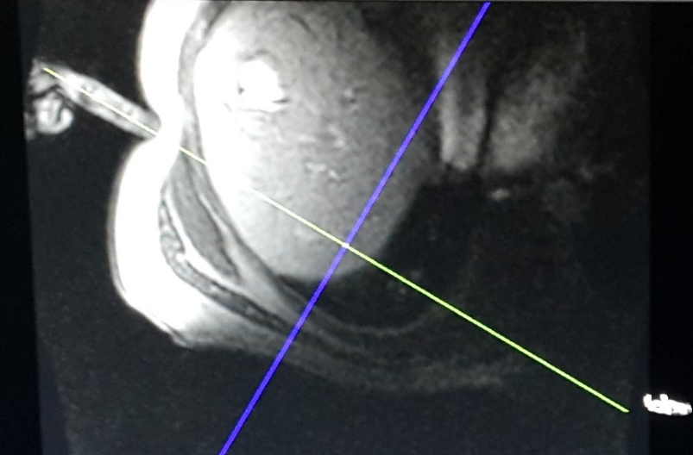
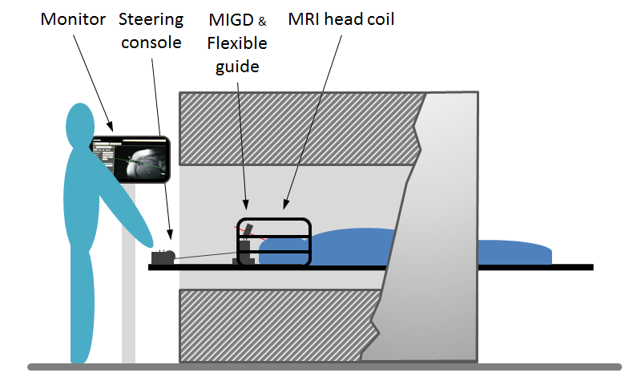
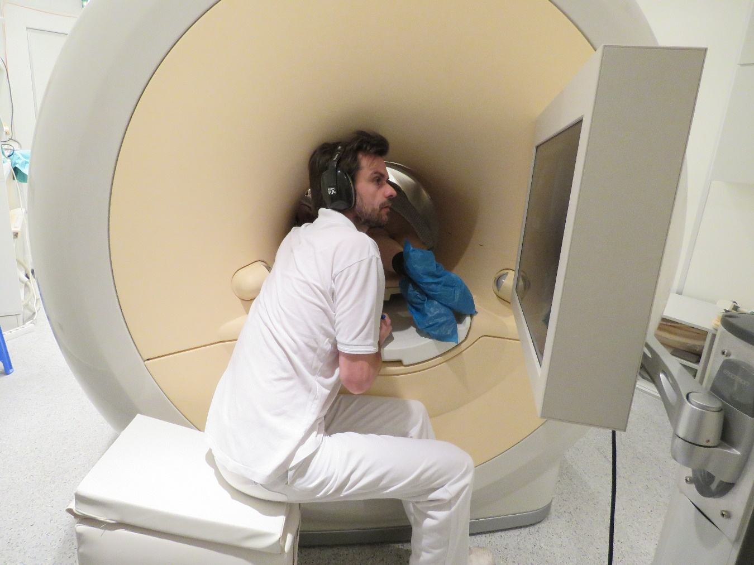
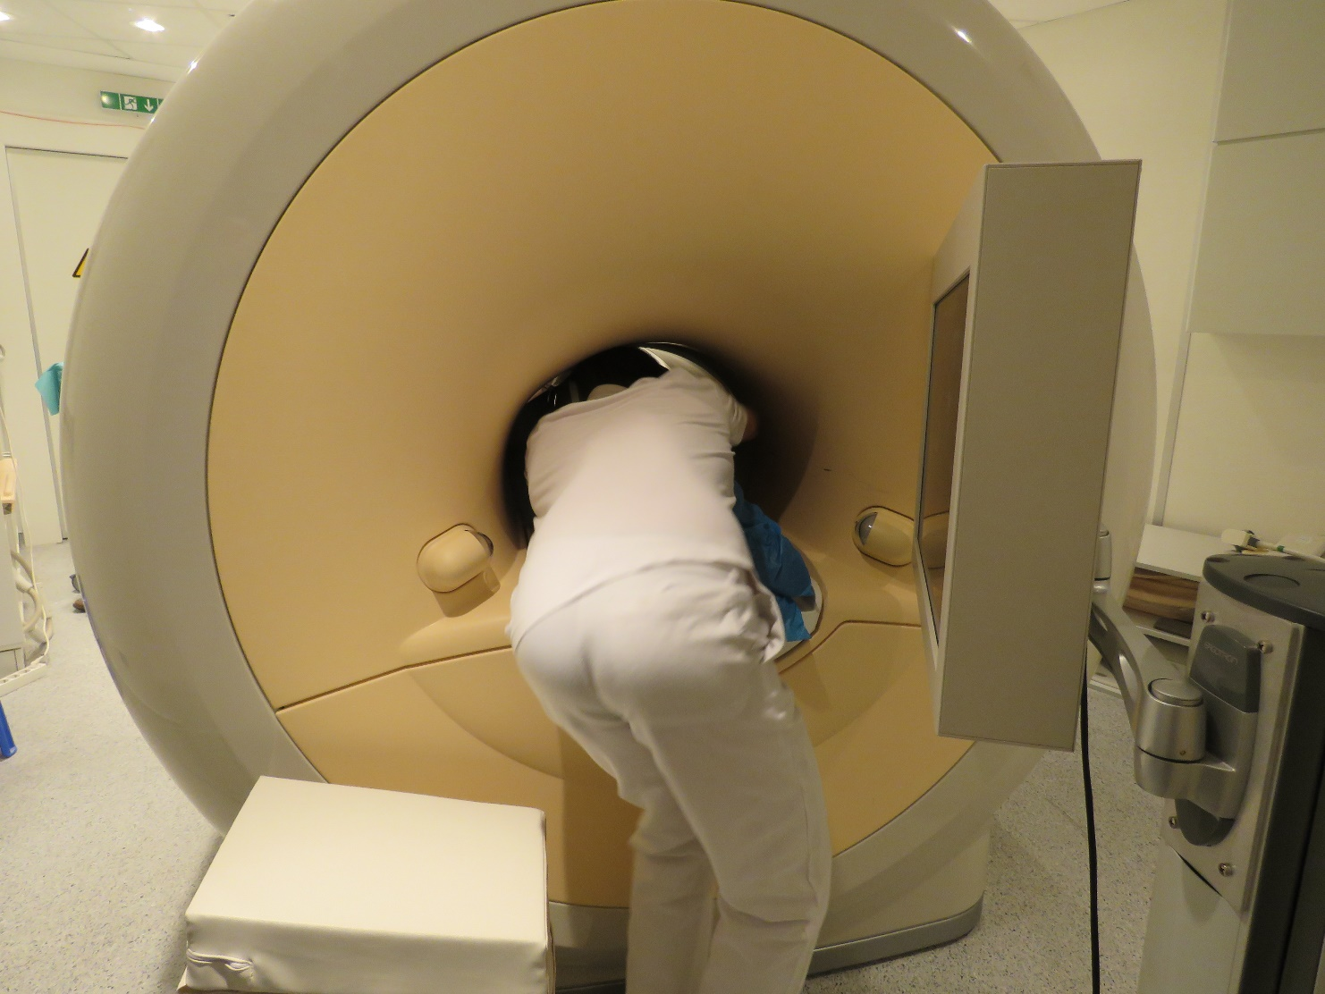
MRI-guided interventions
Application: Biopsy, ablation, neurosurgical interventions
Methods: Freehand approach
MR-compatible mechanical or robotic device
Notes:
The ordered set of fiducial point coordinates P’ are then applied to compute the 6-DOF pose of the Z-frame with respect to the image plane. Finally, the computed frame position and orientation is used to compute the required motion of the robotic device to reach the target pose.

Slide 4
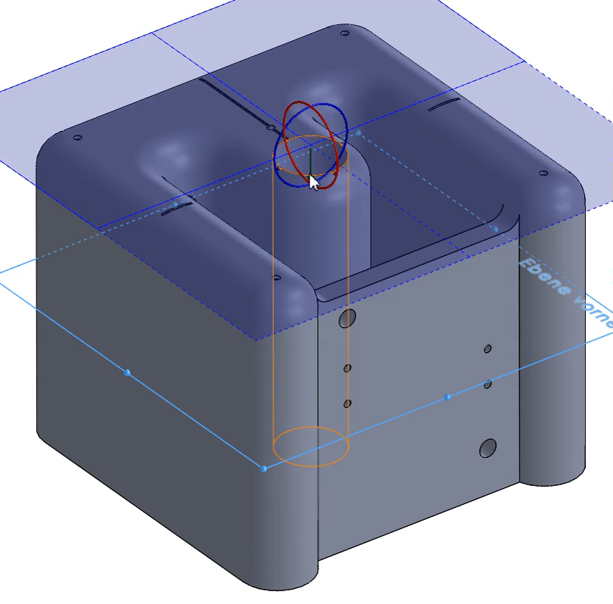
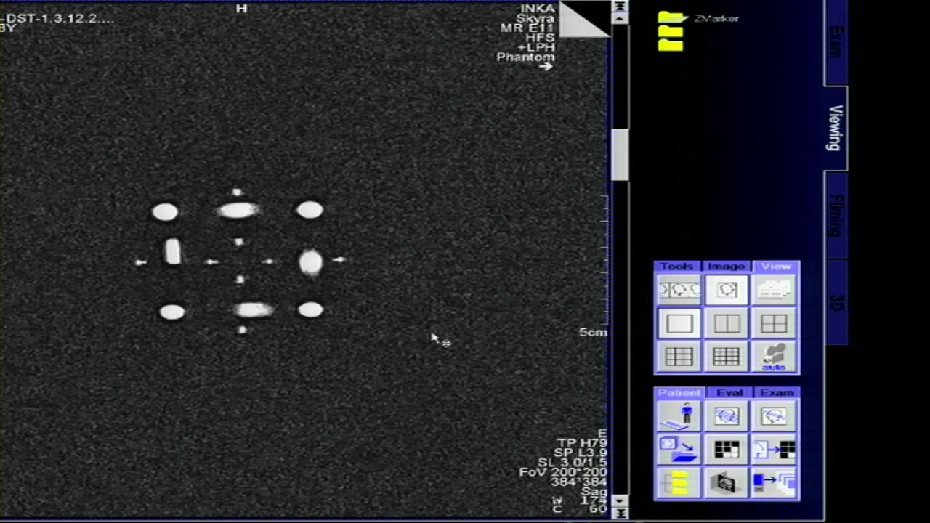
Passive tracking Z-frame marker
Internal cylindrical tunnel structure with 45°-orientation at three sides
Full six degree-of-freedom estimation of a device’s pose in MRI coordinates using a single image slice of the frame
P1
P7
P6
P2
P3
P5
P4
Notes:
Z-frame is a passive tracking marker
control and tracking of the position and orientation of the instrument
designed with internal cylindrical tunnels, which are aligned in vertical and 45°-orientation at three sides (= Z-shape).
A single image slice will show seven ellipses, the centroids are used for localizing the frame
The benefit from the Z-shaped marker design is that the full 6-DOF (DOF = degree of freedom) pose of the device can be extracted from the relationship of the dots that show up on the image.
Our new marker concept uses the same design with the Z-shaped tunnels, but it is fully additively manufactured.

Slide 5
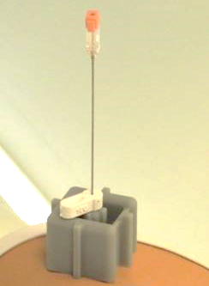
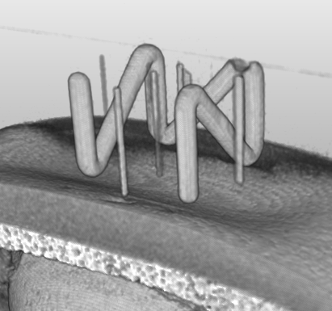
Passive tracking Z-frame marker
Internal cylindrical tunnel structure with 45°-orientation at three sides
Full six degree-of-freedom estimation of a device’s pose in MRI coordinates using a single image slice of the frame
P1
P7
P6
P2
P3
P5
P4
Notes:
Z-frame is a passive tracking marker
control and tracking of the position and orientation of the instrument
designed with internal cylindrical tunnels, which are aligned in vertical and 45°-orientation at three sides (= Z-shape).
A single image slice will show seven ellipses, the centroids are used for localizing the frame
The benefit from the Z-shaped marker design is that the full 6-DOF (DOF = degree of freedom) pose of the device can be extracted from the relationship of the dots that show up on the image.
Our new marker concept uses the same design with the Z-shaped tunnels, but it is fully additively manufactured.

Slide 6
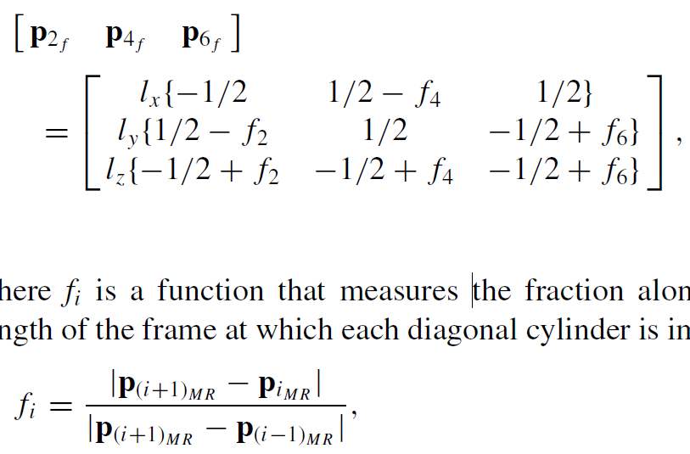
Passive tracking Z-frame marker
Internal cylindrical tunnel structure with 45°-orientation at three sides
Full six degree-of-freedom estimation of a device’s pose in MRI coordinates using a single image slice of the frame
P1
P7
P6
P2
P3
P5
P4
Notes:
Z-frame is a passive tracking marker
control and tracking of the position and orientation of the instrument
designed with internal cylindrical tunnels, which are aligned in vertical and 45°-orientation at three sides (= Z-shape).
A single image slice will show seven ellipses, the centroids are used for localizing the frame
The benefit from the Z-shaped marker design is that the full 6-DOF (DOF = degree of freedom) pose of the device can be extracted from the relationship of the dots that show up on the image.
Our new marker concept uses the same design with the Z-shaped tunnels, but it is fully additively manufactured.

Slide 7
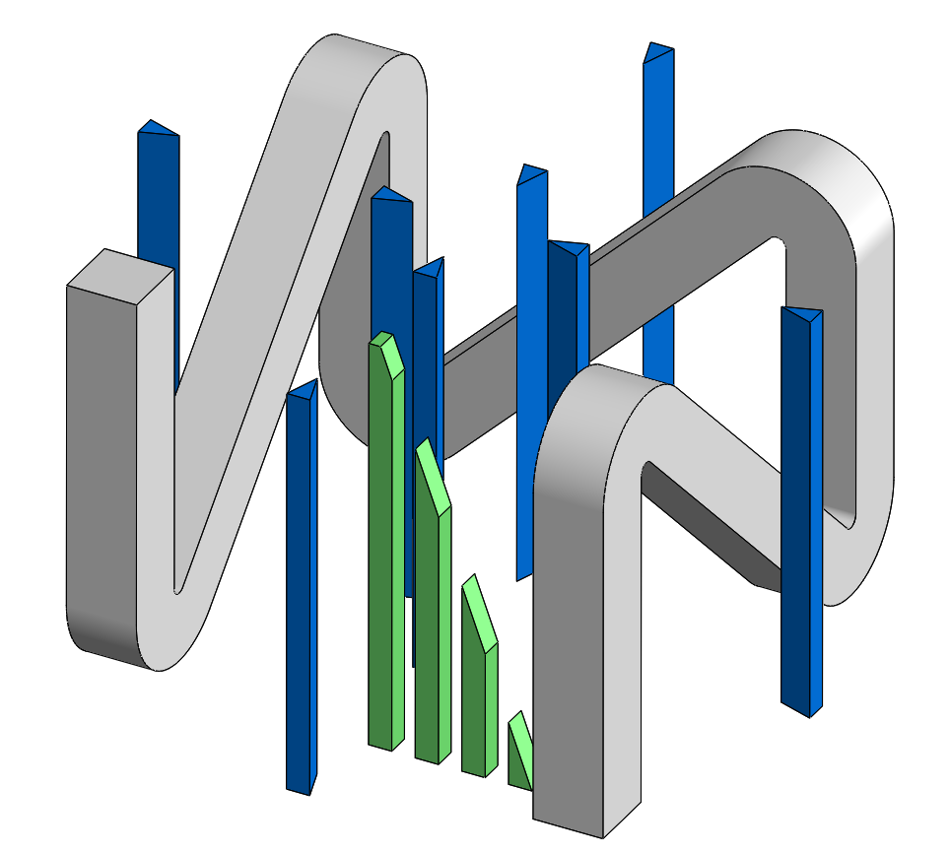
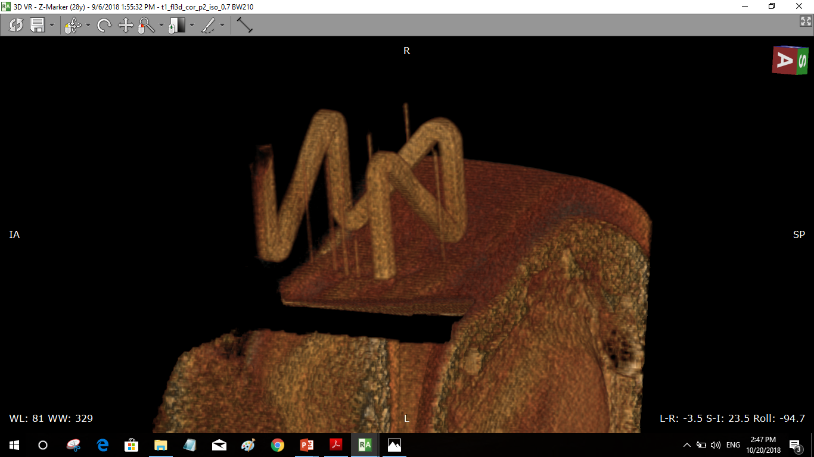
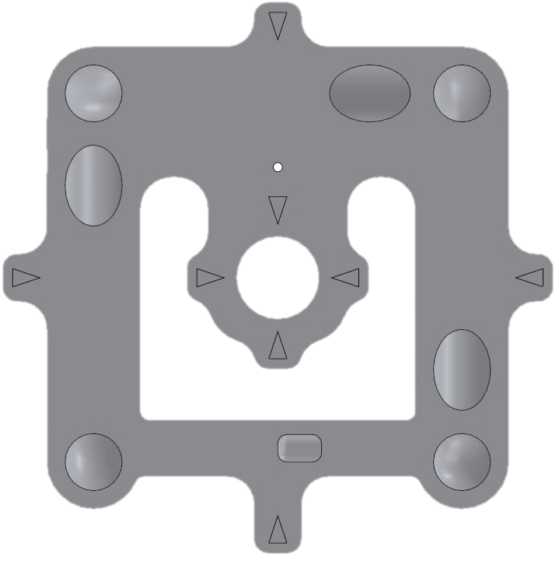
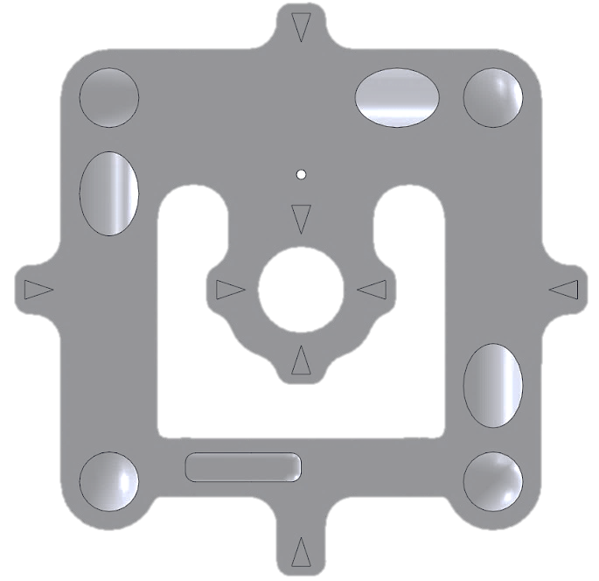
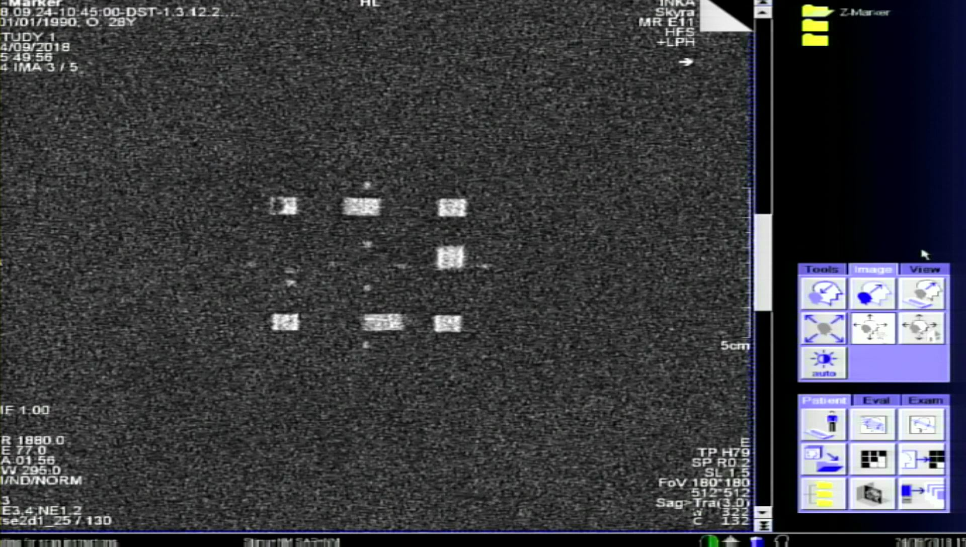
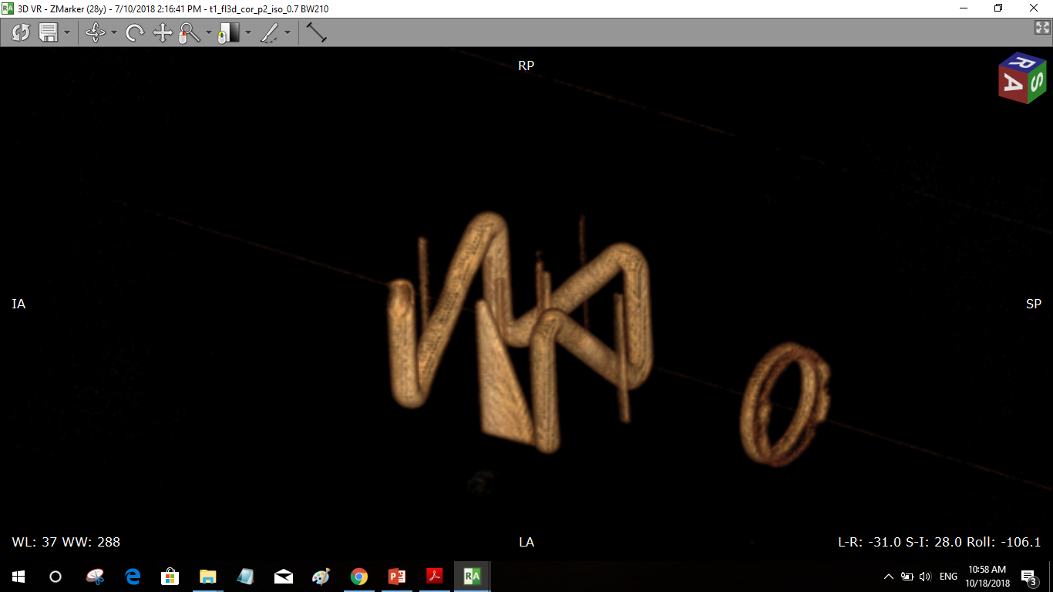
Z-frame physical design
New features:
Square-shaped tunnel structure
Z-axis indication triangle
Center pointing triangles
P4
P4
P4
P5
P3
P3
P5
P5
P3
P6
P2
P6
P2
P2
P6
P7
P1
P1
P7
P7
P1
Top view of the marker
Z= +10 mm
Bottom view of the marker
Z= -10 mm
Notes:
Clear identification of the correct view of the marker
Z-frame is a passive tracking marker
control and tracking of the position and orientation of the instrument
designed with internal cylindrical tunnels, which are aligned in vertical and 45°-orientation at three sides (= Z-shape).
A single image slice will show seven ellipses, the centroids are used for localizing the frame
The benefit from the Z-shaped marker design is that the full 6-DOF (DOF = degree of freedom) pose of the device can be extracted from the relationship of the dots that show up on the image.
Our new marker concept uses the same design with the Z-shaped tunnels, but it is fully additively manufactured.
Center pointing triangles: Indirect detection of the center of the marker
Z-axis indication triangle: Clear identification of the correct view orientation of the marker
Z-RP-MR-marker with the distinct shaped internal tunnels in the CAD-view

Slide 8
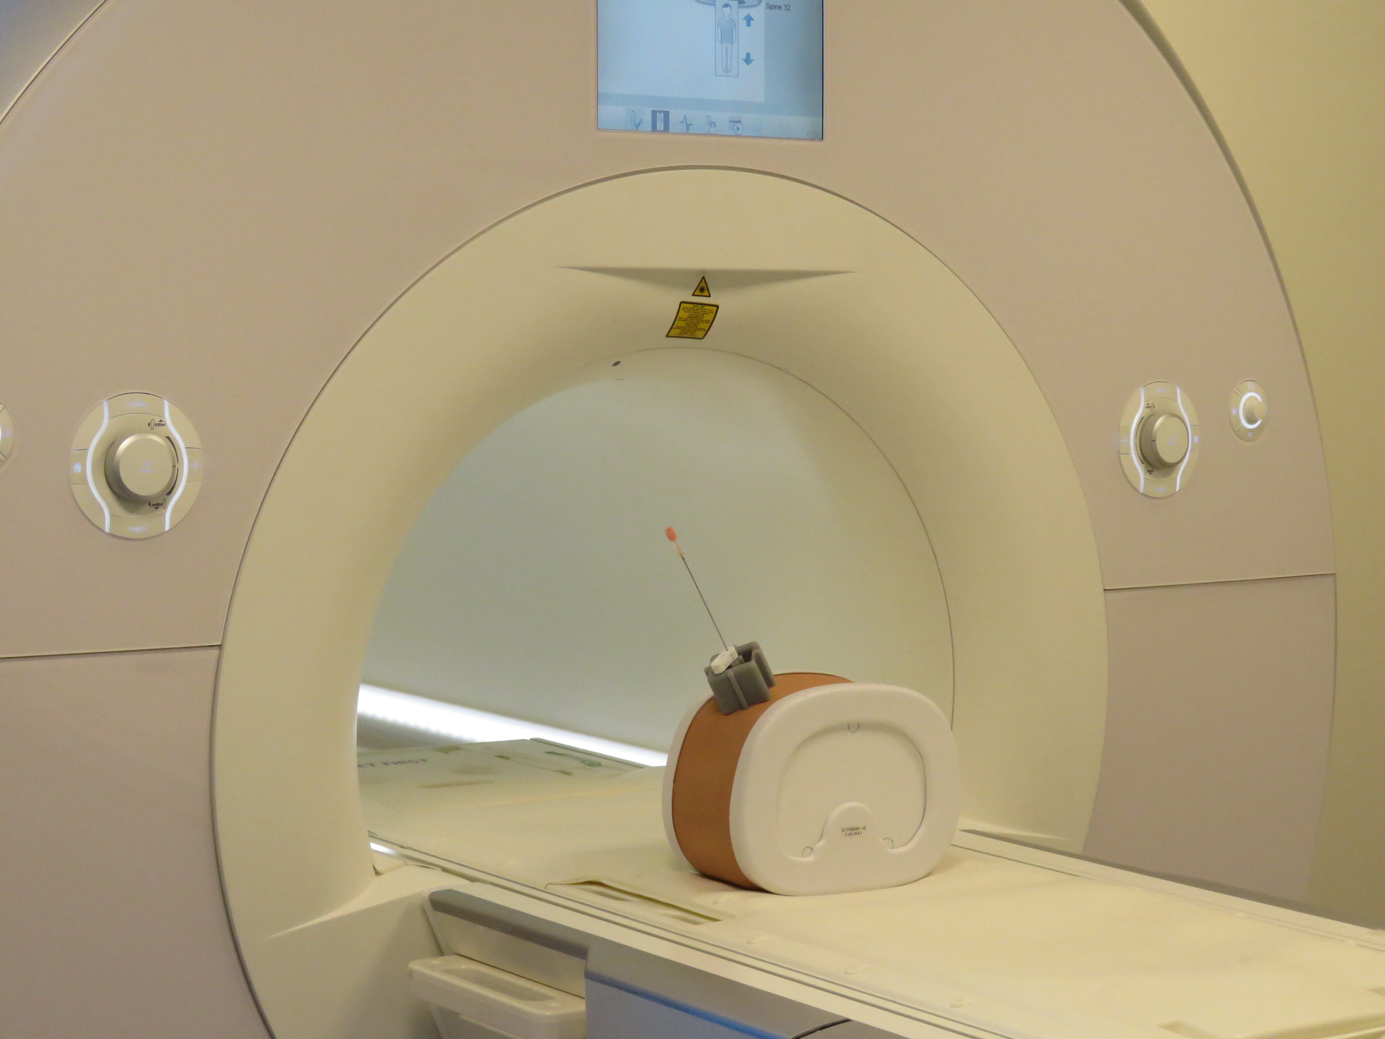
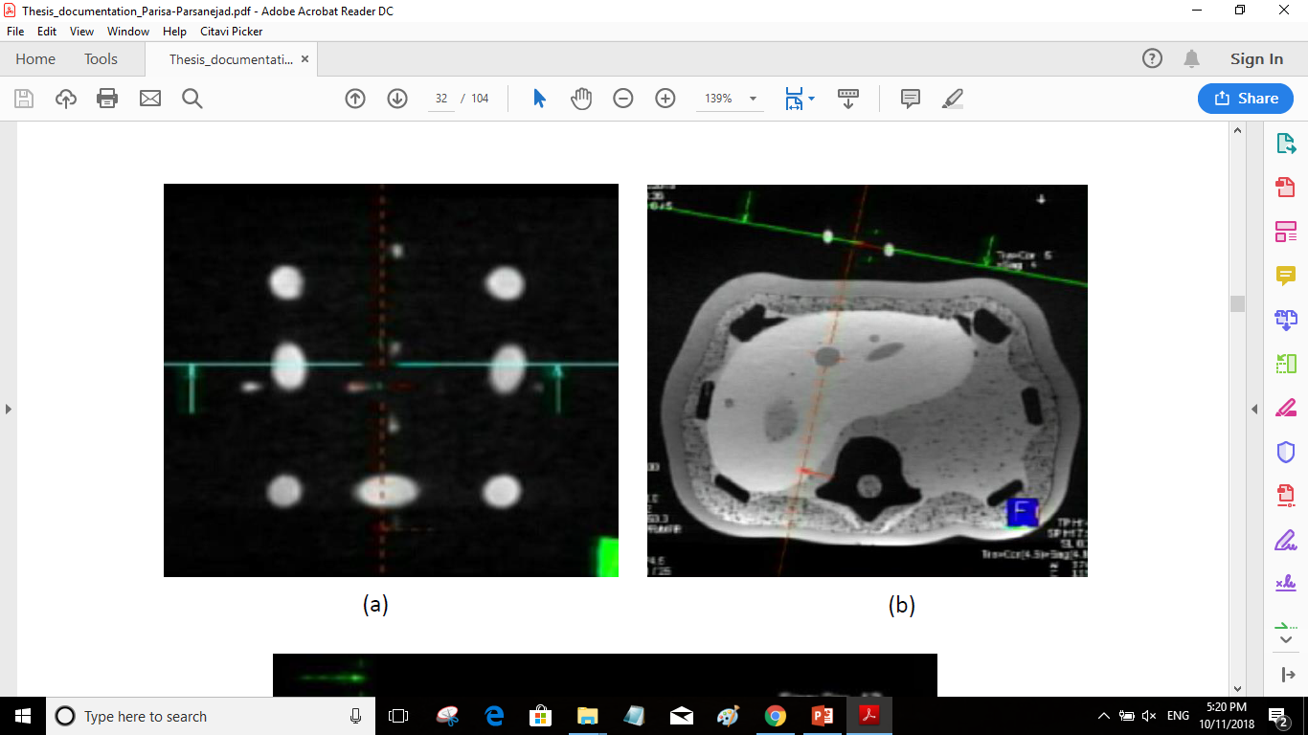
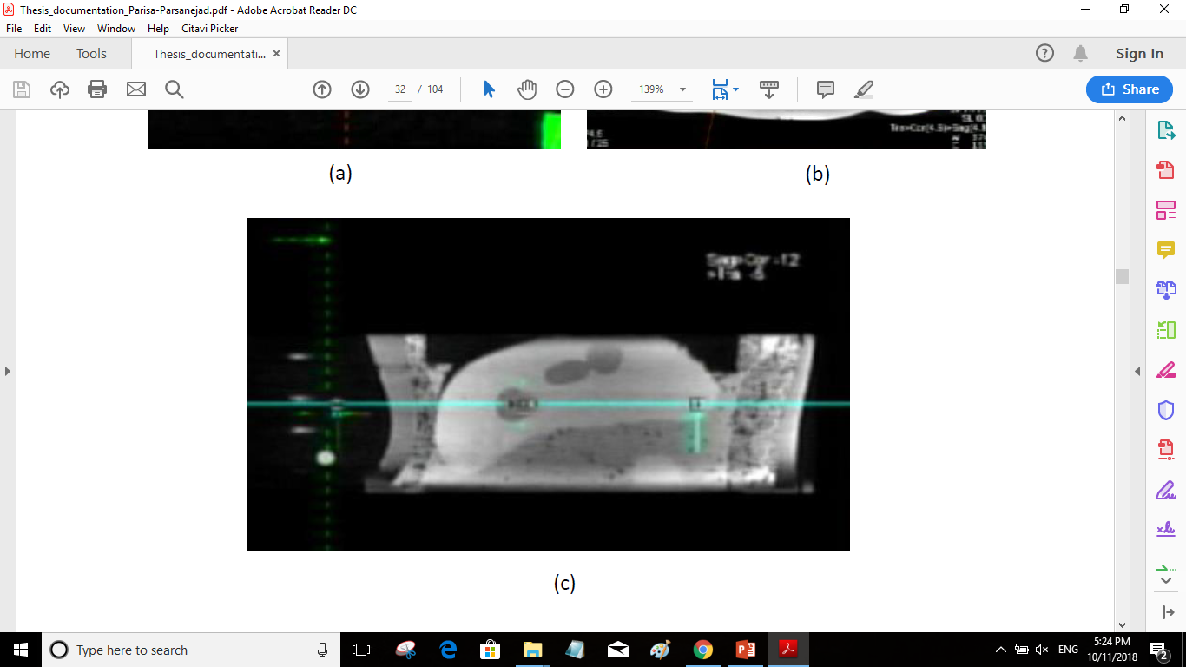
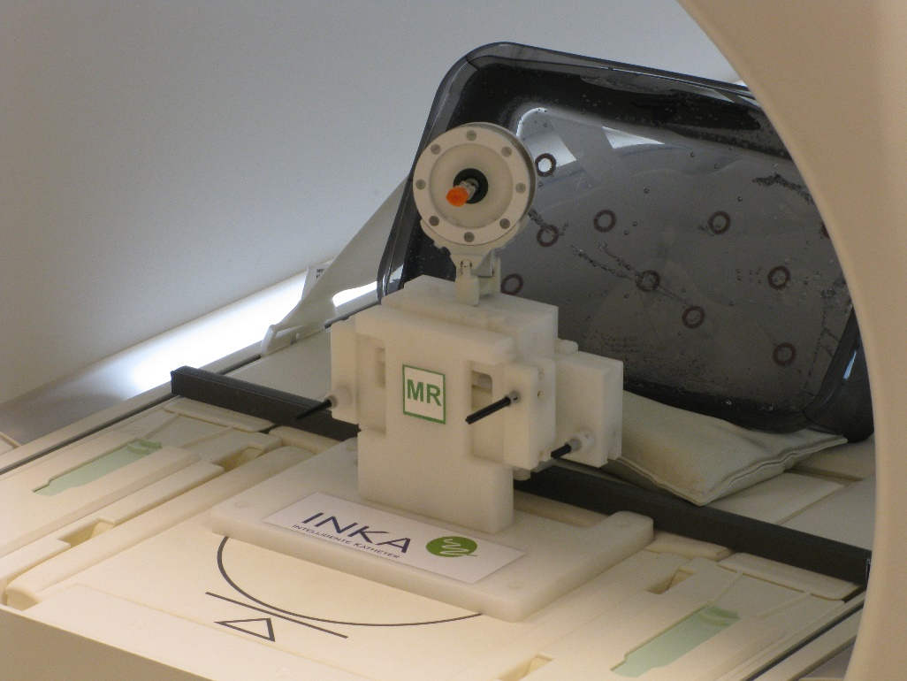
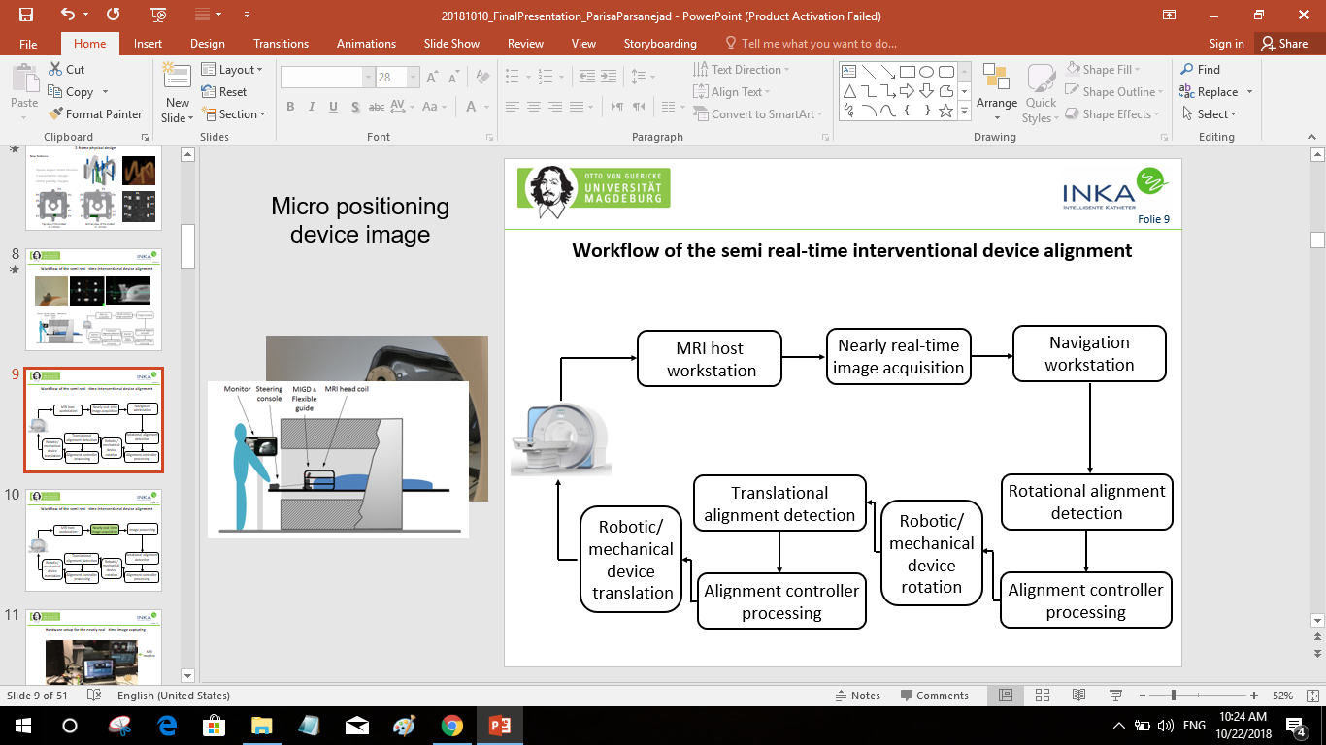
Micro positioning device image
Workflow of the semi real-time interventional device alignment

Slide 9
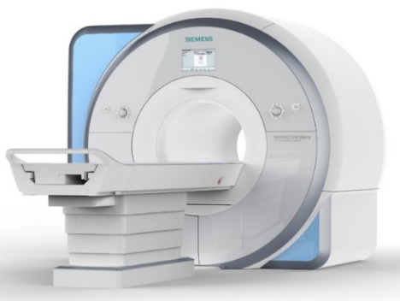
Micro positioning device image
Workflow of the semi real-time interventional device alignment
MRI host
workstation
Nearly real-time
image acquisition
Navigation
workstation
Translational alignment detection
Rotational alignment detection
Robotic/
mechanical device
translation
Robotic/
mechanical device
rotation
Alignment controller
processing
Alignment controller
processing

Slide 10
Micro positioning device image
Workflow of the semi real-time interventional device alignment
MRI host
workstation
Nearly real-time
image acquisition
Navigation
workstation
Translational alignment detection
Rotational alignment detection
Robotic/
mechanical device
translation
Robotic/
mechanical device
rotation
Alignment controller
processing
Alignment controller
processing

Slide 11
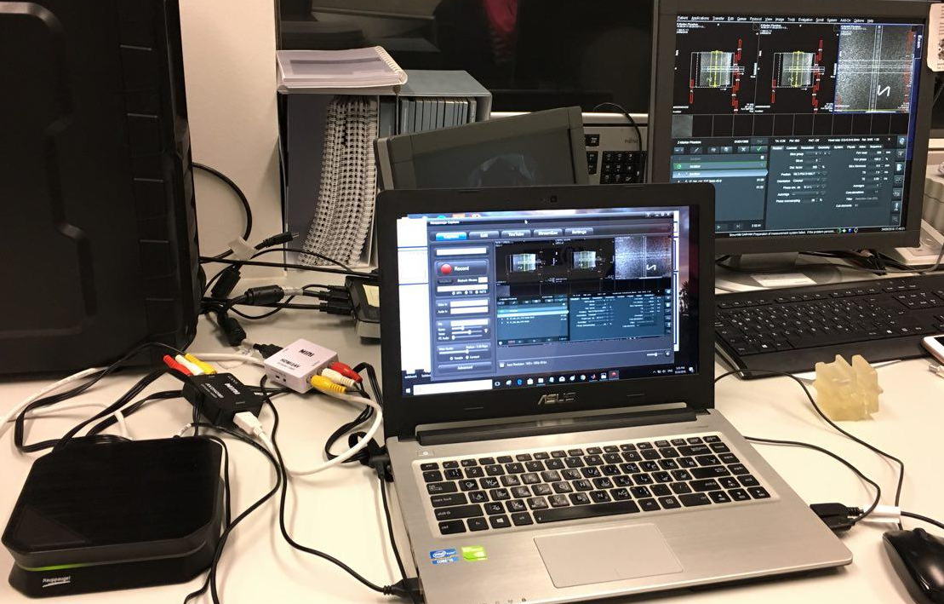
Hardware setup for the nearly real-time image capturing
MRI
monitor
HD- video recorder
AV-converter
Processing laptop

Slide 12
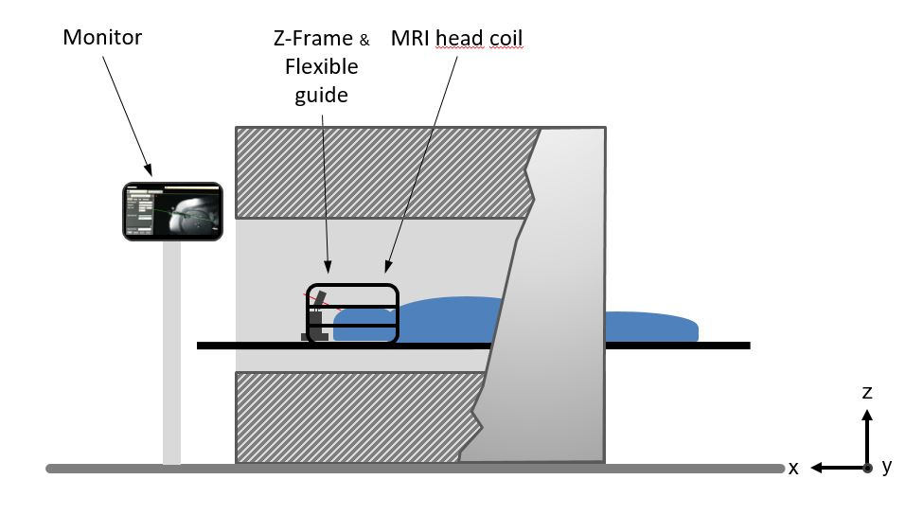
Micro positioning device image
Workflow of the semi real-time interventional device alignment
MRI host
workstation
Nearly real-time
image acquisition
Navigation
workstation
Translational alignment detection
Rotational alignment detection
Robotic/
mechanical device
translation
Robotic/
mechanical device
rotation
Alignment controller
processing
Alignment controller
processing

Slide 13
Navigation workstation: Real-time alignment detection algorithm
Image pre-processing
stage
Localization and registration stage
Marker alignment calculation
Image filtering
and
segmentation
Marker alignment calculation
Rigid transformation matrix
Rigid transformation matrix
Center detection of the fiducials ellipses
Real time image capturing
Robot movement to the target trajectory
Angle calculation of image plane & frame
Angle calculation of image plane & frame
Distance measurements between centroids
Instrument trajectory estimation
Instrument trajectory estimation
Validity test and calibration
Robotic device motion calculation

Slide 14
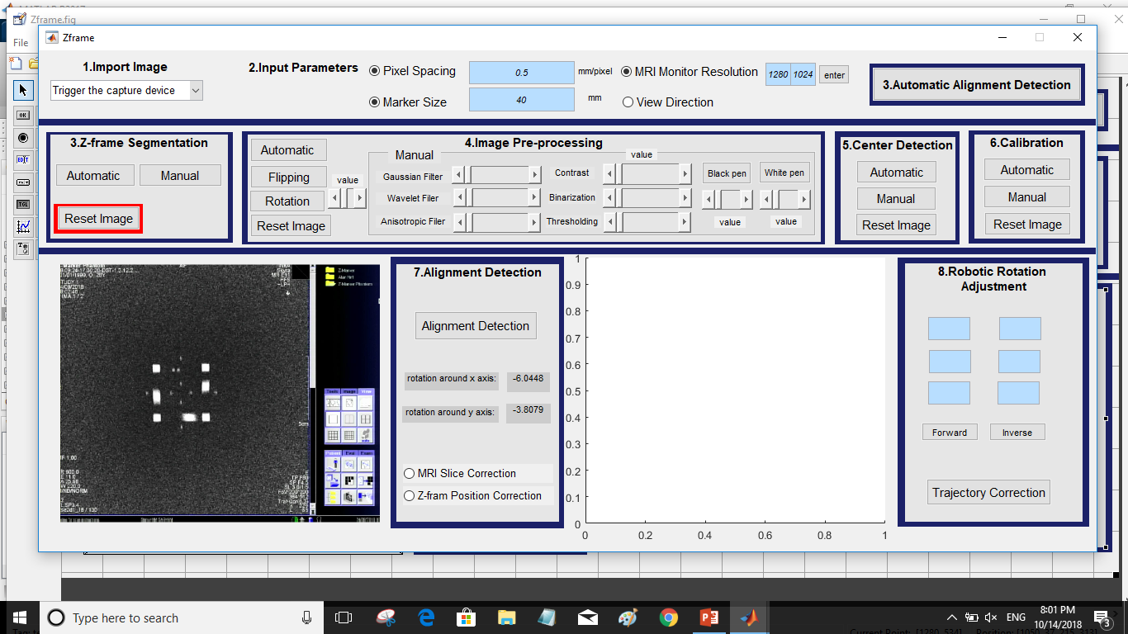
Graphical user interface
Automated alignment detection GUI

Slide 15
Graphical user interface
3. Z-frame Segmentation
Automated alignment detection GUI

Slide 16
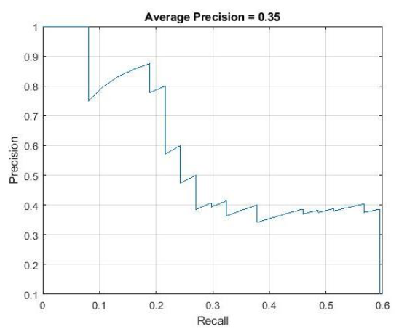
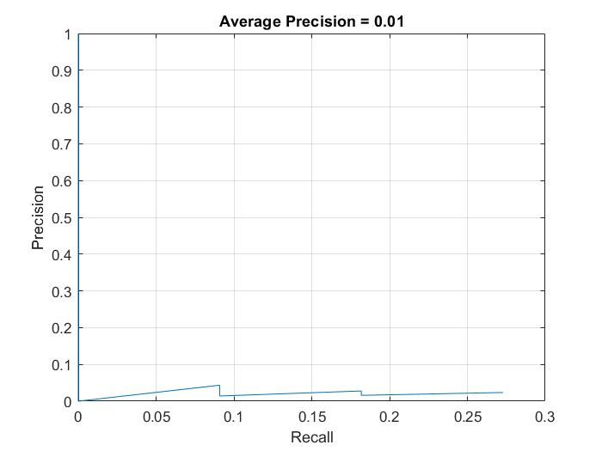
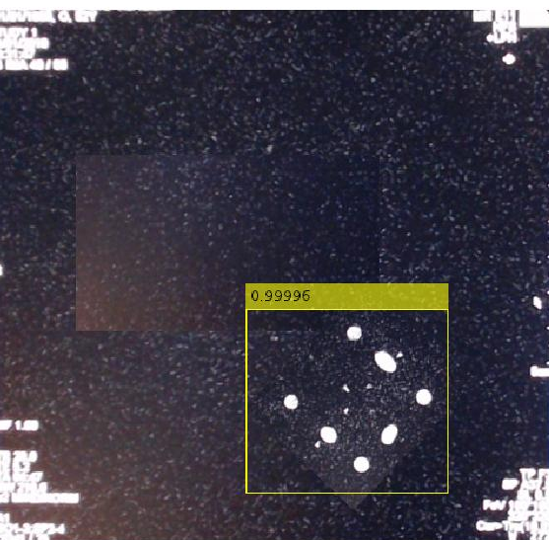
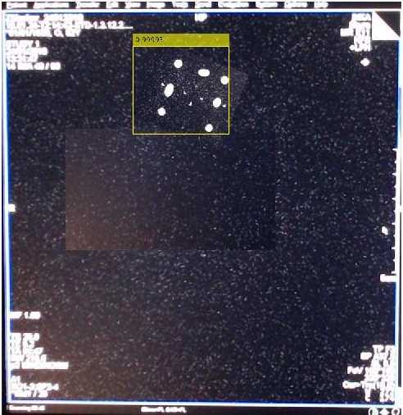
Z-frame detection using faster R-CNN (Regions with Convolutional Neural Networks)
CNN layer:
Input layer
Middle layers: convolution2dLayer, reluLayer (rectified linear units), maxPooling2dLayer
Final layers: fullyConnectedLayer, softmaxLayer
3. Z-frame Segmentation
Automatic button
Average Precision = 0.35
Precision
Recall
Notes:
Start with the imageInputLayer, which defines the type and size of the input layer. For detection tasks, the CNN needs to analyze smaller sections of the image, so the input size must be similar in size to the smallest object in the data set.
This input size is a balance between processing time and the amount of spatial detail the CNN needs to resolve.
Next, define the middle layers of the network. The middle layers are made up of repeated blocks of convolution2dLayer, reluLayer (rectified linear units), and maxPooling2dLayer layers. These layers form the core building blocks of convolutional neural networks.

Slide 17
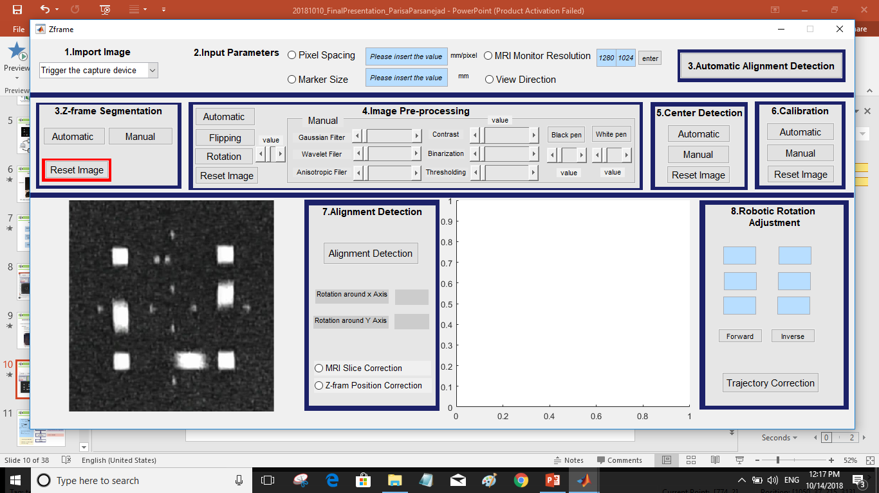
Graphical user interface
4. Image Pre-processing
Automated alignment detection GUI

Slide 18
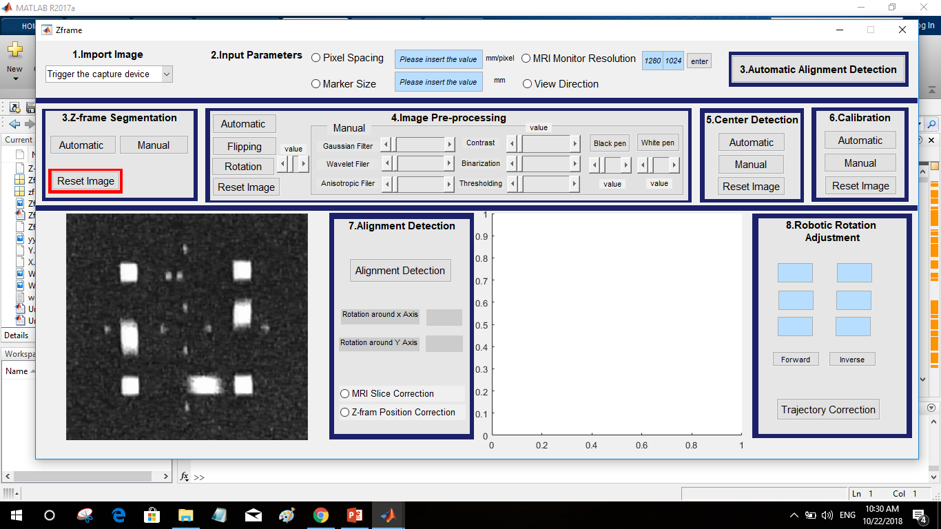

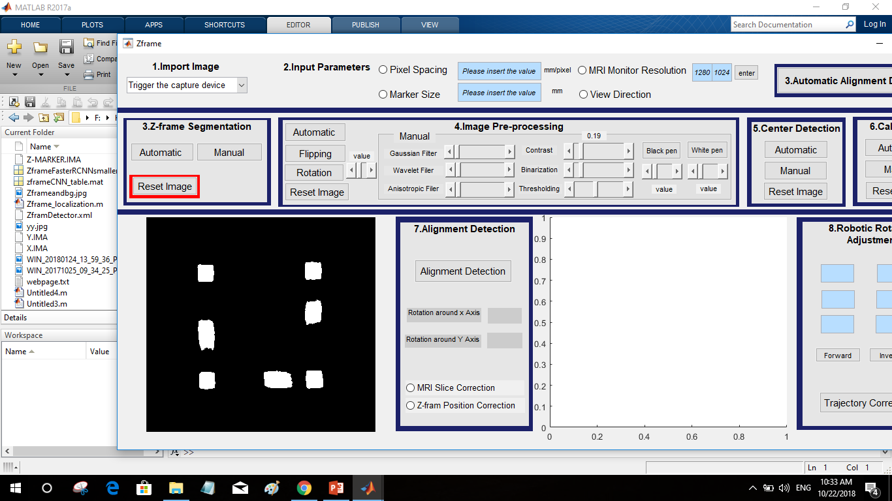
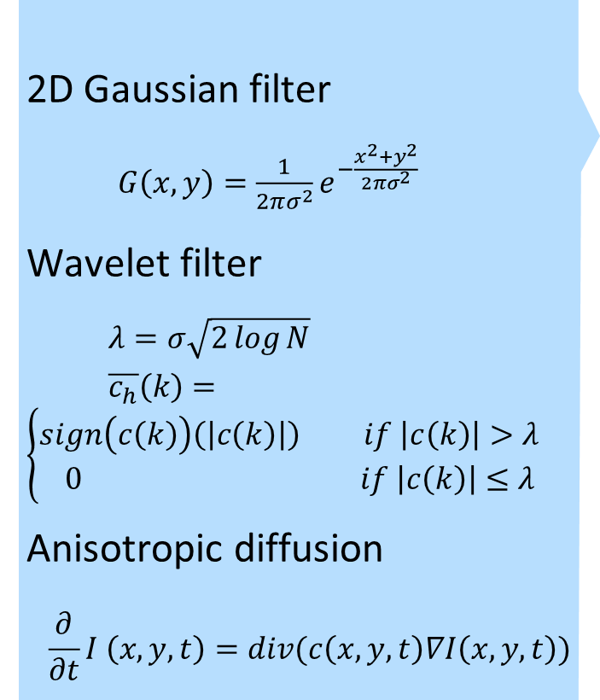
4. Image Pre-processing
2D Gaussian filter
$G\left(x,y\right)=\frac{1}{2πσ^{2}}e^{−\frac{x^{2}+y^{2}}{2πσ^{2}}}$
Wavelet filter
$λ=σ\sqrt{2\log{N}}$
$\overline{c_{h}}\left(k\right)=\left\{\begin{aligned}sign\left(c\left(k\right)\right)\left(\left|c\left(k\right)\right|\right) if \left|c\left(k\right)\right|>λ \\ 0 if \left|c\left(k\right)\right|≤λ\end{aligned}\right.$
Anisotropic diffusion
$$\frac{∂}{∂t}I \left(x,y,t\right)=div(c\left(x,y,t\right)∇I\left(x,y,t\right))$$
% North, South, East and West differences
deltaN = diffl(1:rows,2:cols+1) - diff;
deltaS = diffl(3:rows+2,2:cols+1) - diff;
deltaE = diffl(2:rows+1,3:cols+2) - diff;
deltaW = diffl(2:rows+1,1:cols) - diff;
% Conduction
if option == 1
cN = exp(-(deltaN/kappa).^2);
cS = exp(-(deltaS/kappa).^2);
cE = exp(-(deltaE/kappa).^2);
cW = exp(-(deltaW/kappa).^2);
elseif option == 2
cN = 1./(1 + (deltaN/kappa).^2);
cS = 1./(1 + (deltaS/kappa).^2);
cE = 1./(1 + (deltaE/kappa).^2);
cW = 1./(1 + (deltaW/kappa).^2);
end
diff = diff + lambda*(cN.*deltaN + cS.*deltaS + cE.*deltaE + cW.*deltaW);
end
Image intensity values adjustment
Image= imadjust(Image,[0.5 .9],[0 1])
Noise
removal
Contrast
enhancement
Image thresholding
Image= im2bw(Image,0.5);
Image
binarization
Removal of the small objects from the image
mask= bwareaopen(I,50); Image = imclearborder(mask);
Binary
masking
Notes:
The main drawback of the linear filtering is that the details in the original image will be destroyed during reducing the noise.
Anisotropic diffusion filtering proposed by Perona and Malic [reference] is a technique which reduces the image noise but preserves details and even enhances edges.

Slide 19
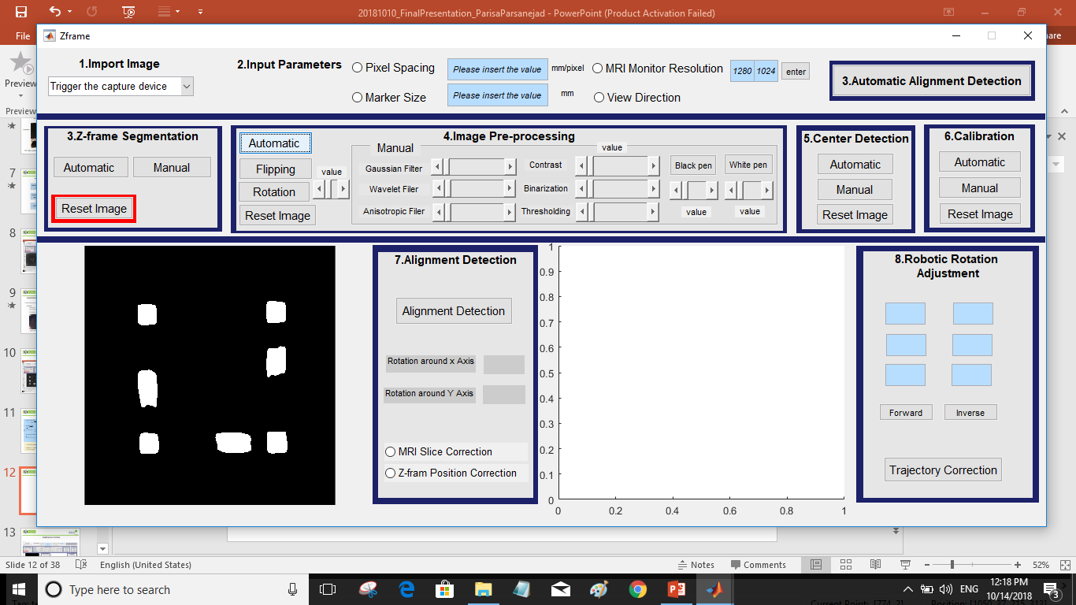
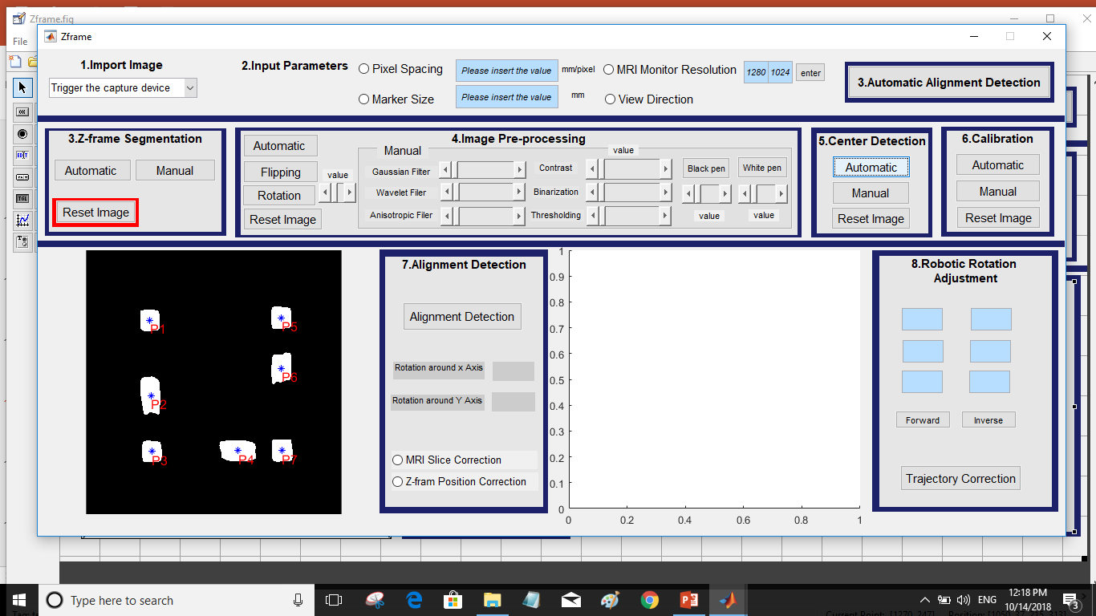
Graphical user interface
5. Center Detection
Automated alignment detection GUI
s = regionprops(mask,'centroid');
centroids = cat(1, s.Centroid);
centroids = round(centroids);
figure
imshow(Image)
hold on
plot(centroids(:,1),centroids(:,2), 'b*')
hold off
[m n]=size(centroids)

Slide 20
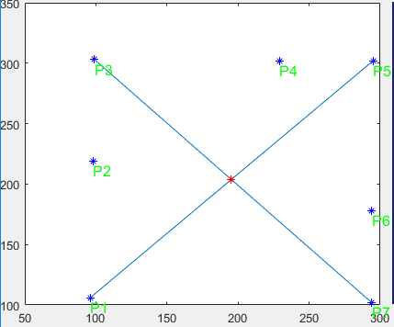
Graphical user interface
6. Calibration
Automated alignment detection GUI
R = [cos(theta) -sin(theta); sin(theta) cos(theta)];
x_intersect = fzero(@(x) polyval(p1-p2,x),3)
y_intersect = polyval(p1,x_intersect)
line(x1,y1);
line(x2,y2);
% transfer the points into new coordinate system
P(:,1)=P(:,1)-x_intersect
P(:,2)=P(:,2)-y_intersect
% Convert Pixel to mm
[ps_camera_x,ps_camera_y] = camera_calibration(P)
P(:,1)=P(:,1)*ps_camera_x
P(:,2)=P(:,2)*ps_camera_y

Slide 21
Workflow of the semi real-time interventional device alignment
MRI host
workstation
Nearly real-time
image acquisition
Navigation
workstation
Translational alignment detection
Rotational alignment detection
Robotic/
mechanical device
translation
Robotic/
mechanical device
rotation
Alignment controller
processing
Alignment controller
processing

Slide 22
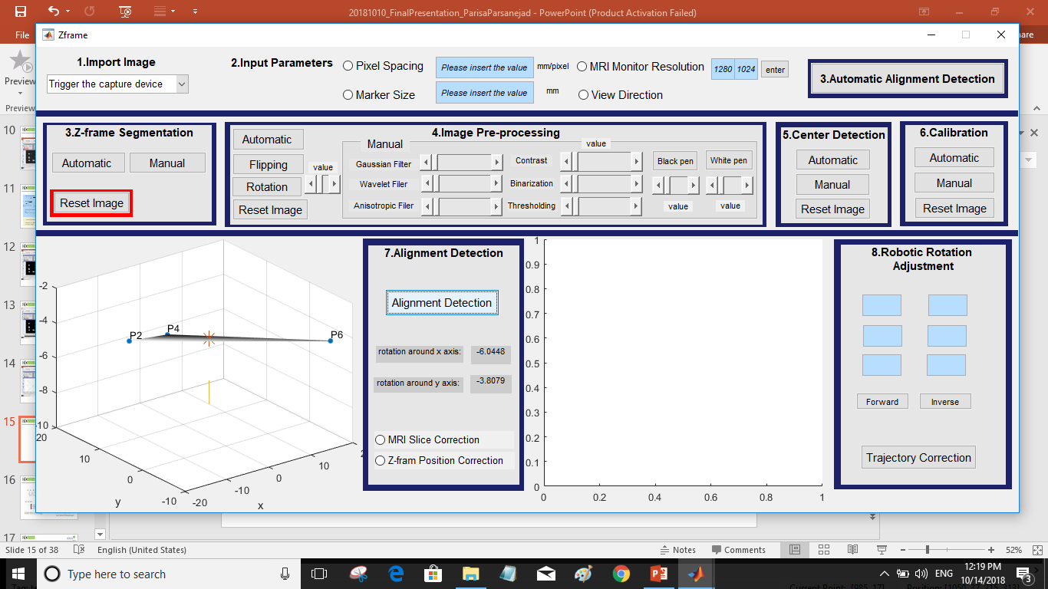
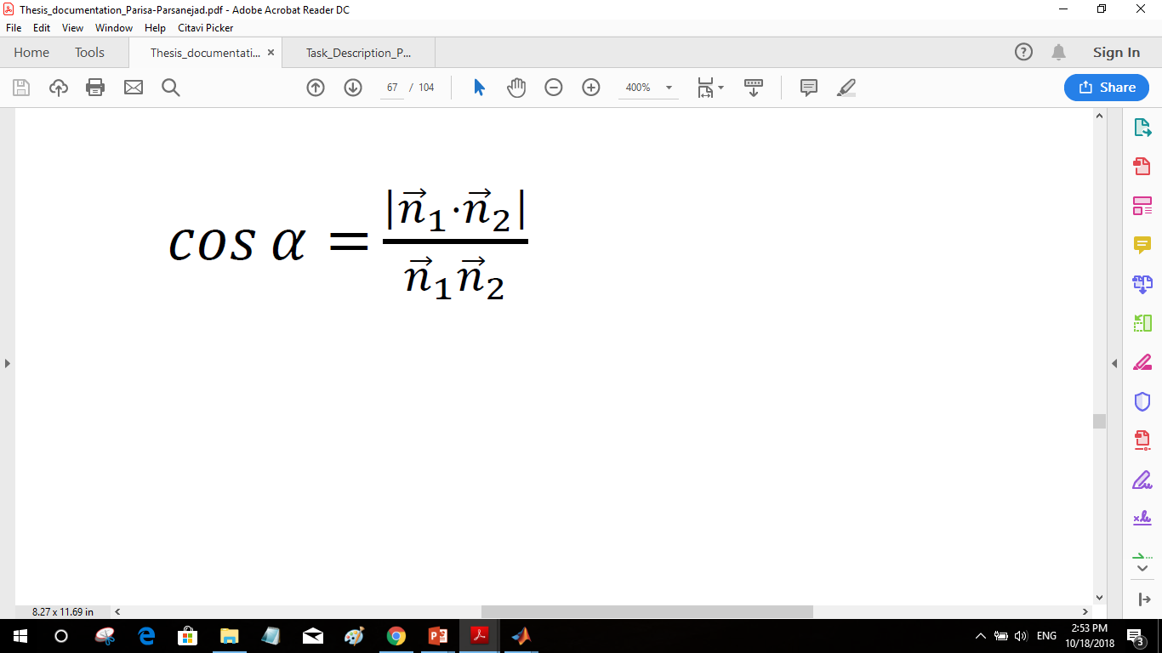
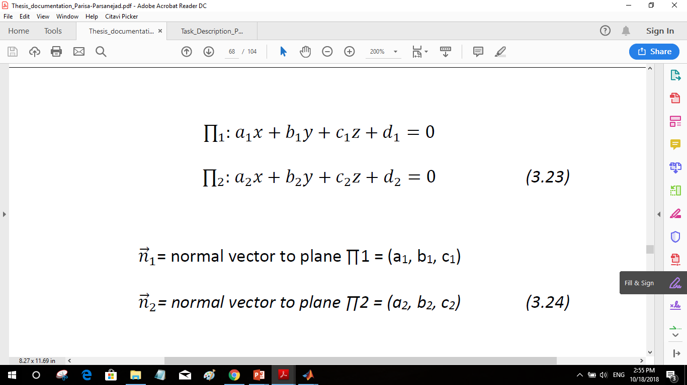
Graphical user interface
7. Alignment detection
Automated alignment detection GUI

Slide 23
Micro positioning device image
Workflow of the semi real-time interventional device alignment
MRI host
workstation
Nearly real-time
image acquisition
Navigation
Workstation
Translational alignment detection
Rotational alignment detection
Robotic/
mechanical device
translation
Robotic/
mechanical device
rotation
Alignment controller
processing
Alignment controller
processing

Slide 24
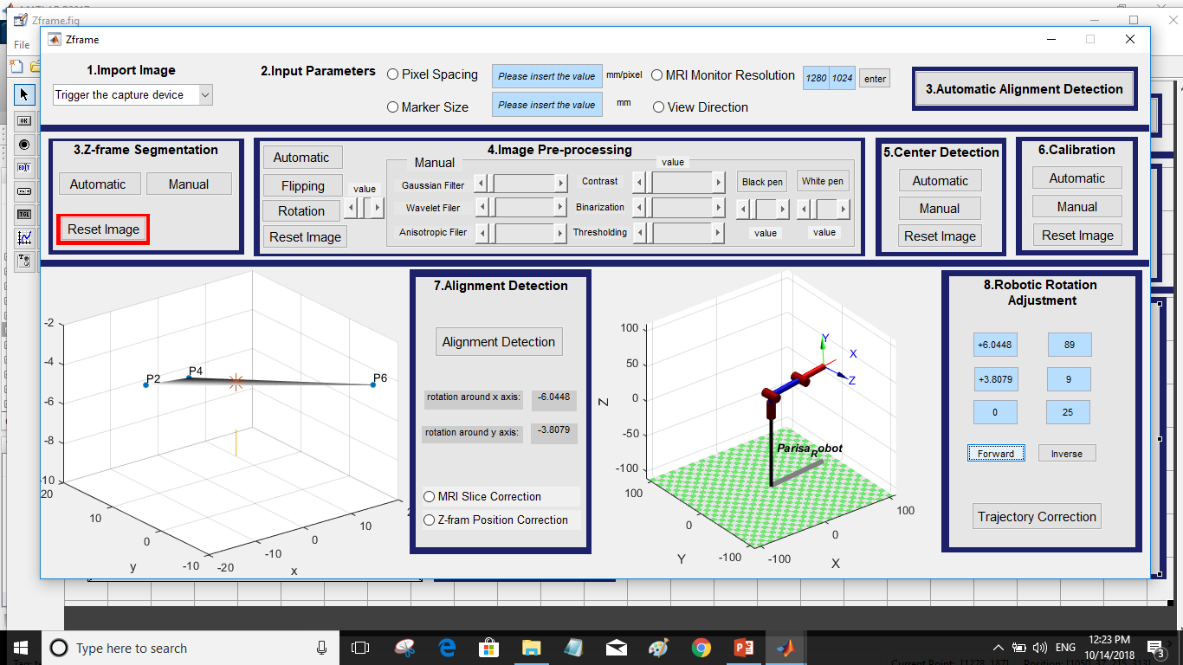
Graphical user interface
8. Robotic Rotation Adjustment
Automated alignment detection GUI

Slide 25
Workflow of the semi real-time interventional device alignment
MRI host
workstation
Nearly real-time
image acquisition
Navigation
workstation
Translational alignment detection
Rotational alignment detection
Robotic/
mechanical device
translation
Robotic/
mechanical device
rotation
Alignment controller
processing
Alignment controller
processing

Slide 26
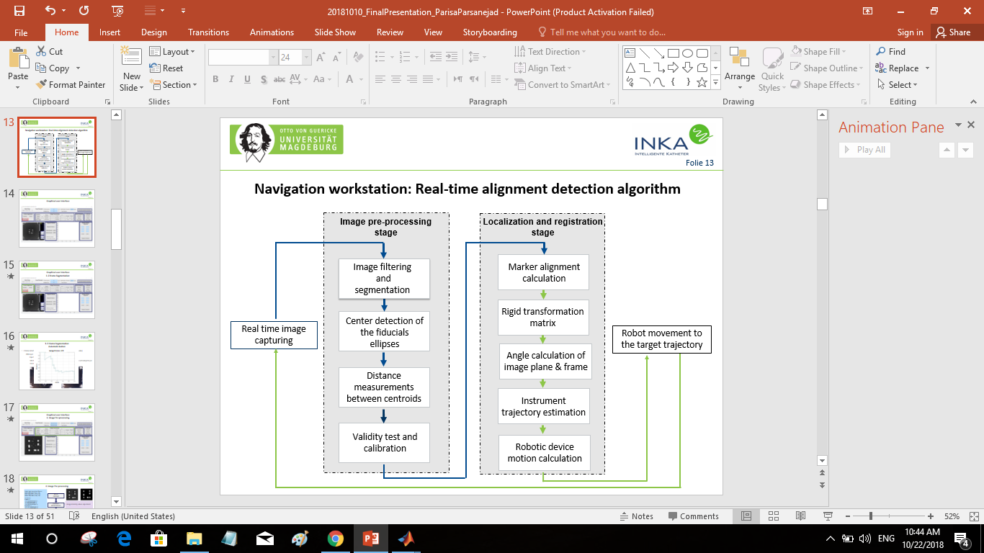

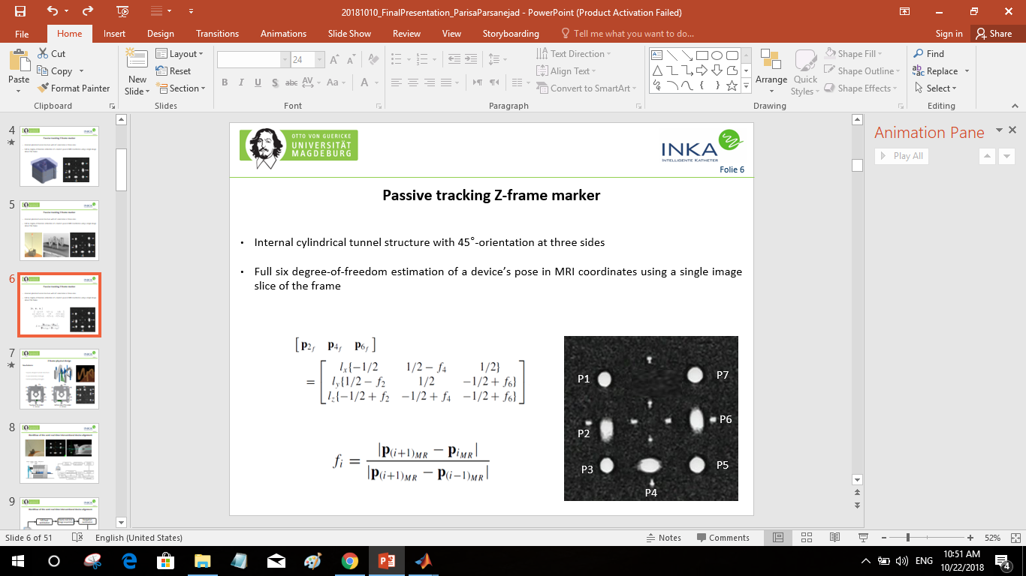
Testing and analysis
Sources of error
Alignment detection algorithm
Capture device resolution
MR-imaging artifacts
Z-frame printing artifact (air bubbles)
Positioning frame’s accuracy

Slide 27
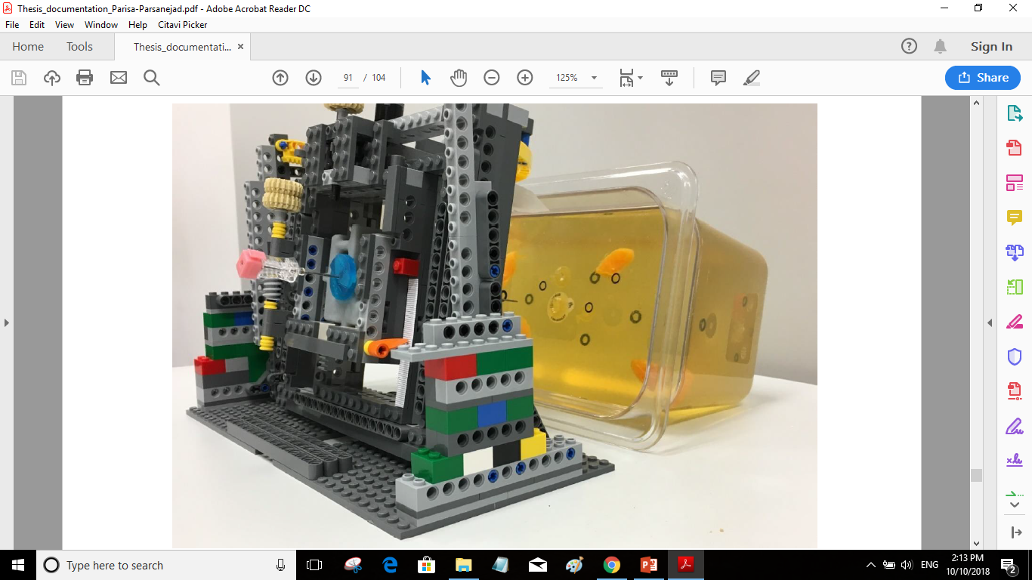
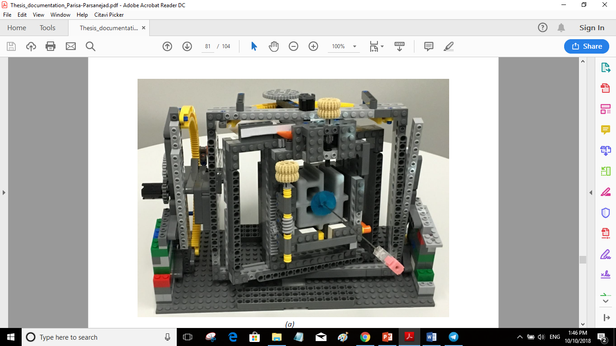
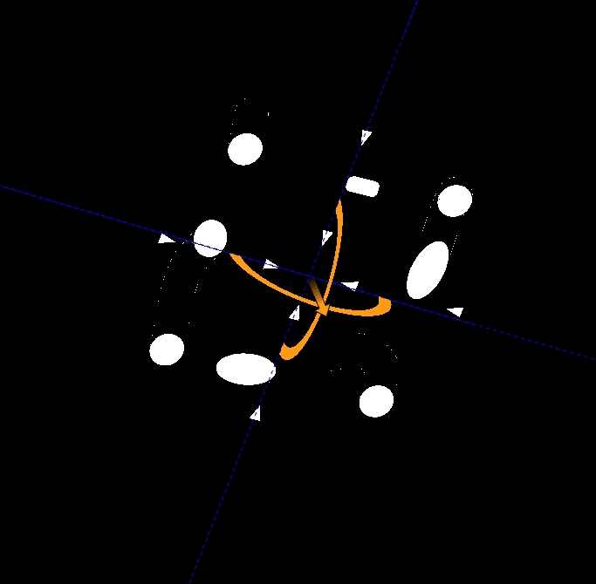
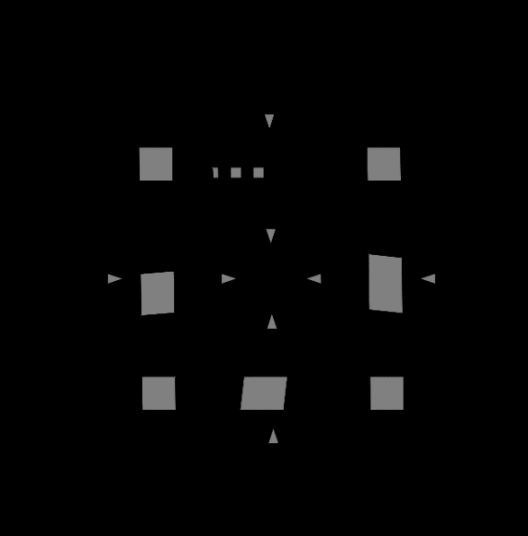
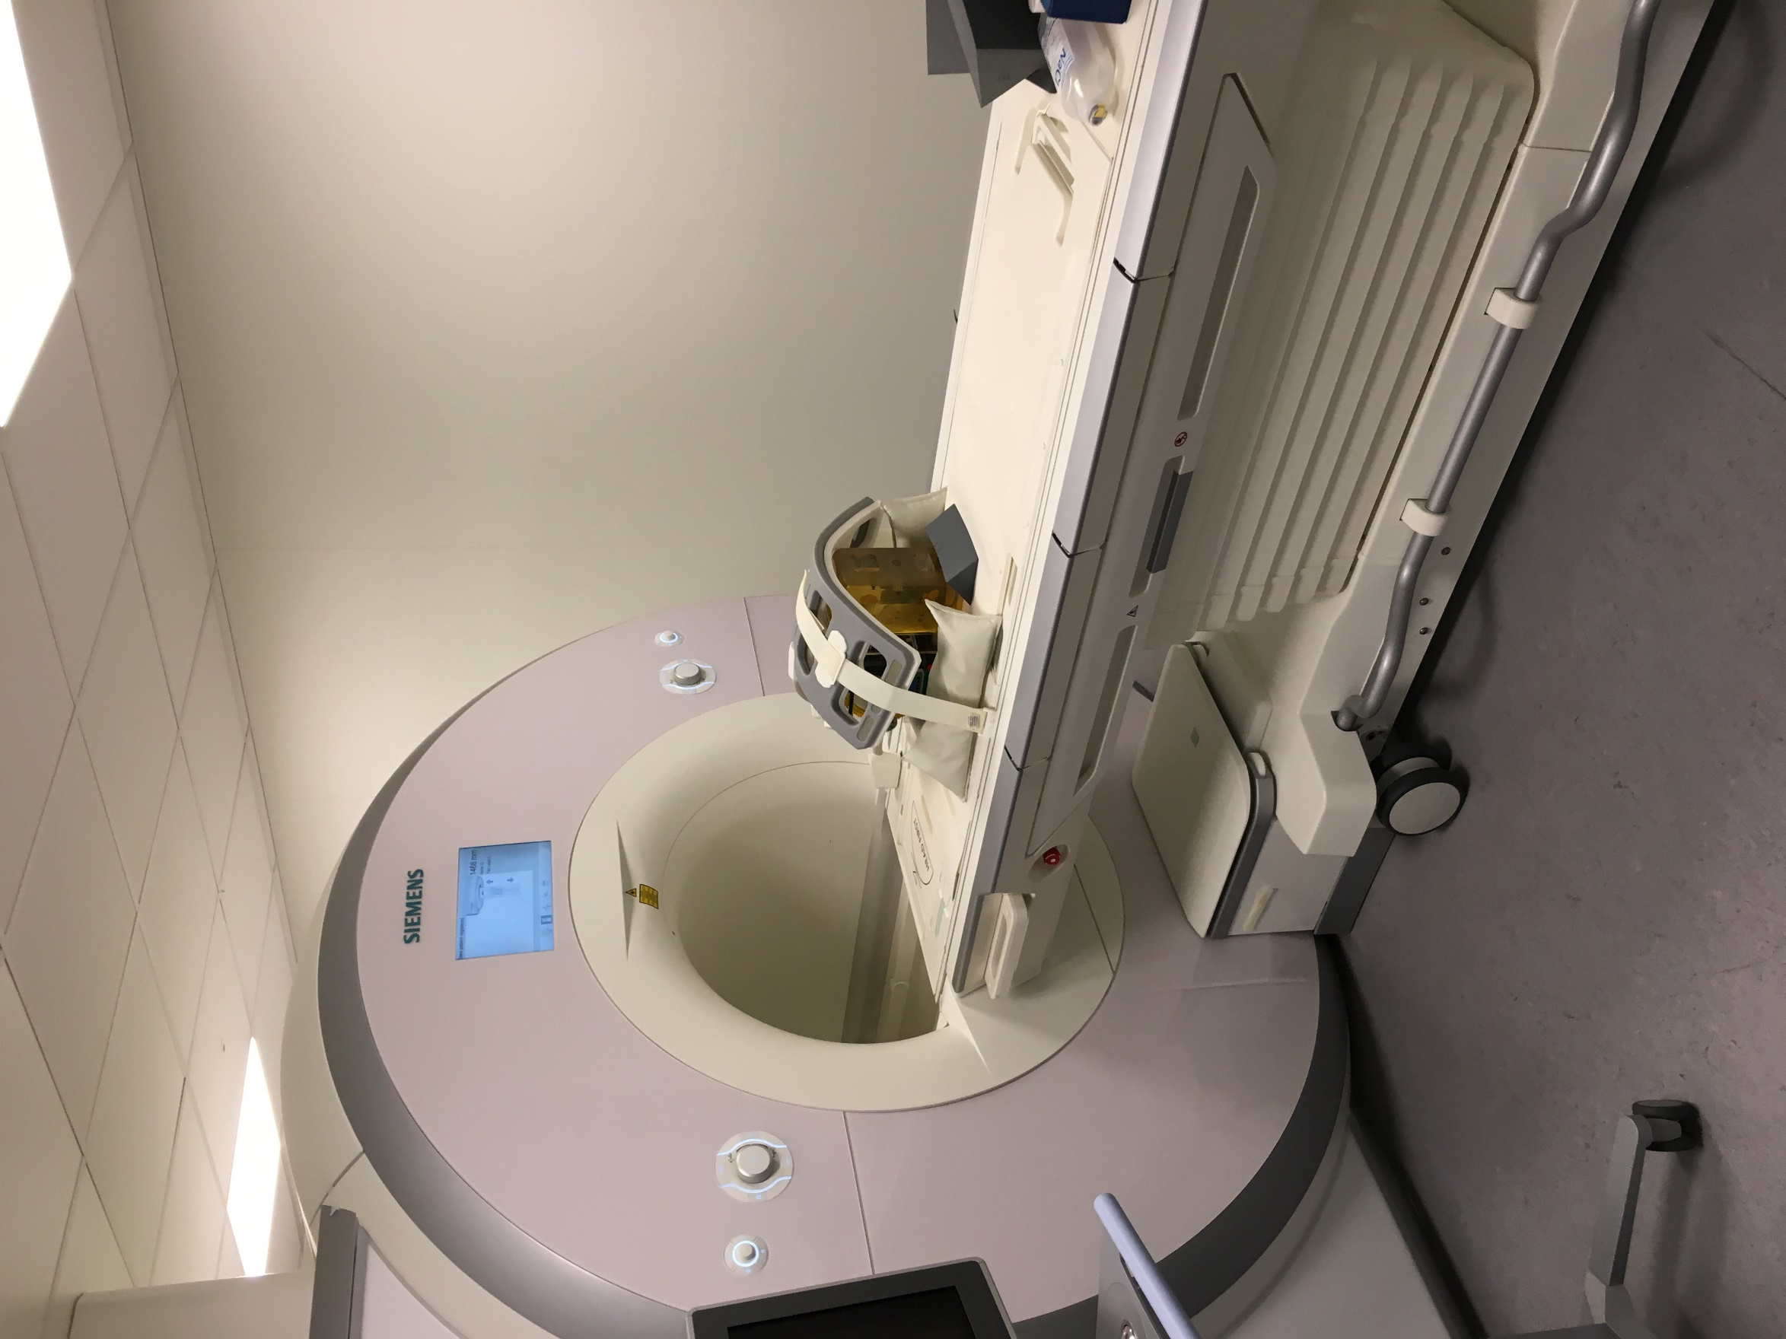
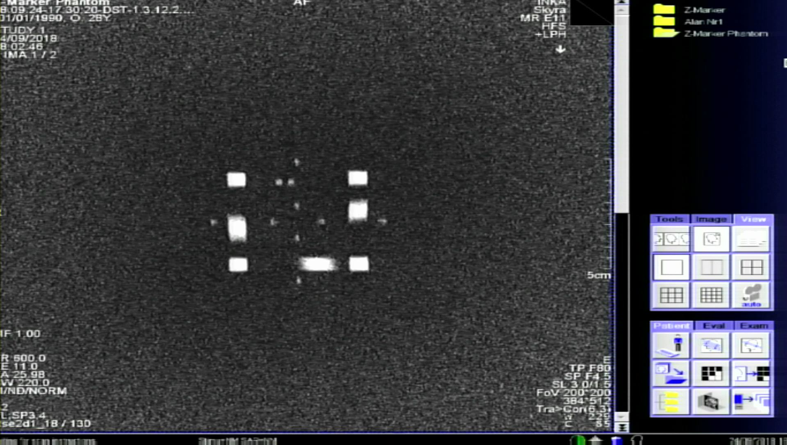
Testing and analysis
Scenarios
Scenario 1: Gold standard CAD analysis
Scenario 2: Z-frame marker positioning
using an MR-compatible rotary frame
Scenario 3: Phantom targeting test
Rotation of the Z-frame around the x-axis
Rotation of the Z-frame around the y-axis
Rotation of the Z-frame around both the x- and y-axis with the same orientation
Rotation of the Z-frame around both the x- and y-axis with the opposite orientation

Slide 28
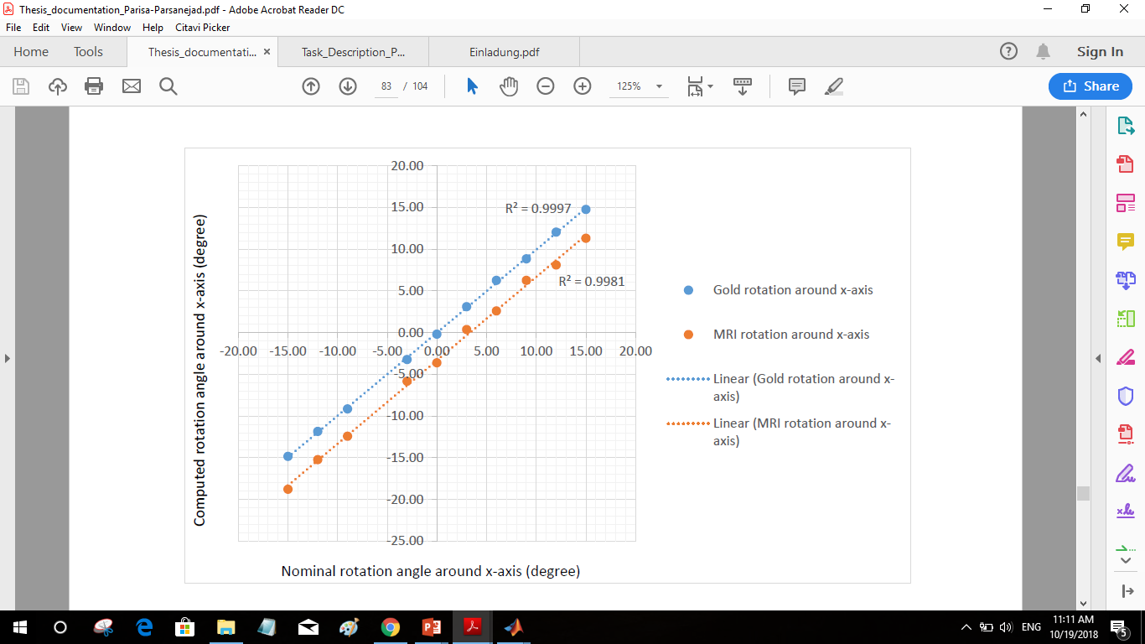







Result analysis: Gold standard and MRI positioning scenarios

Slide 29
R-squared interpretation
Rotation of the Z-frame around (degree) | R² for the gold standard rotation around the x-axis | R² for the gold standard rotation around the y-axis | R² for the MRI rotation around the x-axis | R² for the MRI rotation around y-axis
X-axis | 0.9997 | - | 0.9981 | -
Y-axis | - | 0.9999 | - | 0.9991
X- and Y-axes (same direction) | 0.999 | 0.9974 | 0.9998 | 0.9989
X- and Y-axes (opposite direction) | 0.9998 | 0.9958 | 0.9997 | 0.9975
Average R² | 0.9995 | 0.9977 | 0.9992 | 0.9985
Total R² | 0.9986 |  | 0.9988

Slide 30
Root mean squared error interpretation
Rotation of the Z-frame around (degree) | RMSE for the gold standard rotation around the x-axis | RMSE for the gold standard rotation around the y-axis | RMSE for the MRI rotation around the x-axis | RMSE for the MRI rotation around y-axis
X-axis | 0.18 | - | 0.49 | -
Y-axis | - | 0.13 | - | 0.51
X- and Y-axes (same direction) | 0.32 | 0.66 | 0.18 | 0.38
X- and Y-axes (opposite direction) | 0.26 | 0.21 | 1.0 | 0.47
Average RMSE | 0.25 | 0.33 | 0.56 | 0.45
Total RMSE | 0.29 |  | 0.50

Slide 31
Root mean squared error analysis
Rotation of the Z-frame around (degree) | RMSE for the gold standard rotation around the x-axis | RMSE for the gold standard rotation around the y-axis | RMSE for the MRI rotation around the x-axis | RMSE for the MRI rotation around y-axis
X-axis | 0.18 | - | 0.49 | -
Y-axis | - | 0.13 | - | 0.51
X- and Y-axes (same direction) | 0.32 | 0.66 | 0.18 | 0.38
X- and Y-axes (opposite direction) | 0.26 | 0.21 | 1.0 | 0.47
Average RMSE | 0.25 | 0.33 | 0.56 | 0.45
Total RMSE | 0.29 |  | 0.50
Alignment detection
algorithm
Capture device resolution
MR-imaging
Z-frame printing artifact
positioning frame
Alignment detection algorithm

Slide 32


Scenario 3: Phantom targeting test
Rotation around x-axis= -6.04⁰
Rotation around y-axis= -3.81⁰
Rotation around x-axis= -0.52⁰
Rotation around y-axis= -0.62⁰

Slide 33


Phantom targeting test
40mm

Slide 34


Phantom targeting test

Slide 35

Conclusion and Outlook
The proposed registration and tracking method:
Image acquisition time: 20 sec
Rotation processing time : 15 -20 sec
Rotation adjustment time: 2 min
Image acquisition time: 20 sec
Translation processing time: 15 sec
Translation adjustment time : 2 min
RMSE : 0.5 degree
No need for an additional interface for
connecting the MRI scanner and the
navigation software
Improvement in the automatic segmentation of the Z-frame using a machine learning technique
Applying a robotic rotary device
Automatic computation of the translational alignment of the Z-frame marker
Implementation of a new capture device with a higher quality and the better converters

Slide 36
Conclusion and outlook
The proposed registration method can contribute to a faster and more precise guiding of the MRI-based interventions

Slide 37
References
Cepek, Jeremy, Blaine A. Chronik, and Aaron Fenster. "Errors in device localization in MRI using Z-Frames." International Conference on Medical Image Computing and Computer-Assisted Intervention. Springer, Berlin, Heidelberg, 2013.
2. Su, Hao, et al. "A concentric tube continuum robot with piezoelectric actuation for MRI-guided closed-loop targeting." Annals of biomedical engineering 44.10 (2016): 2863-2873.
3. DiMaio, Simon P., et al. "Dynamic MRI scan plane control for passive tracking of instruments and devices." International Conference on Medical Image Computing and Computer-Assisted Intervention. Springer, Berlin, Heidelberg, 2007.
Tokuda, Junichi, et al. "Configurable automatic detection and registration of fiducial frames for device-to-image registration in MRI-guided prostate interventions." International Conference on Medical Image Computing and Computer-Assisted Intervention. Springer, Berlin, Heidelberg, 2013.
Cepek, J., Chronik, B. A., & Fenster, A. (2014). The effects of magnetic field distortion on the accuracy of passive device localization frames in MR imaging. Medical physics, 41(5).
Odenbach, R.; Grundmann, M.; Boese, A.; Friebe, M.: Generatively manufactured, passive and safe MRI-marker. In 11th Interventional MRI Symposium, Baltimore, 2016
Odenbach, R.; Chen, Y.; Sengupta, S.; Webster, R.; Barth, E.; Friebe, M.: 3D-printed Z-frame marker for MRI-guided interventions. In 16. Jahrestagung der Deutschen Gesellschaft fuer Computer- und Roboterassistierte Chirurgie, Hannover, 2017
Mattern, H.; Odenbach, R.; Parsanejad, P.; and Friebe, M.: 3D-printed MRI marker for personalized interventional applications through T1 and T2 relaxation time matching. In CARS 2018 Computer Assisted Radiology and Surgery, Berlin, Germany, 2018

Slide 38




Thank you for your attention!
Parisa Parsanejad
Parisa.parsanejad@ovgu.de
INKA - Catheter Technologies
Institute for Medical Systems
Faculty of Electrical Engineering and Information Technologies
Otto-von-Guericke-University Magdeburg
Rötgerstr. 9, D-39104 Magdeburg
www.inka-md.de
This work is funded by the BMBF (03IPT7100X)

Slide 39
Backup

Slide 40



Z-frame marker characterization

Slide 41


Configuration of robot-assisted iMRI
Robotic
Device with
Attached
Z-frame
Marker
Scanner Room
MRI Scanner
Robot Controller
MRI Hardware
Control Room
Status
Command
Navigation
Workstation
MRI Host Workstation

Slide 42

Automated alignment detection algorithm

Slide 43






Calibration:
Automatic rotation of the fiducial points
P1
P1
P1
P1
P1
P1

Slide 44


Image filtering steps
2D Gaussian filter:
Localization error = 0.7327
Anisotropic diffusion
Localization error= 0.6114
Median Filter
Localization error= 0.6114
Noise
removal
Localization error:
the Euclidean distance between the predicted marker location, computed from the z-frame registration, and its true position as measured in MR images:
D=Pf-P
LE=norm(D)
Contrast
enhancement
Image
binarization
Z-frame registration:
Binary
masking
Notes:
The main drawback of the linear filtering is that the details in the original image will be destroyed during reducing the noise.
Anisotropic diffusion filtering proposed by Perona and Malic [reference] is a technique which reduces the image noise but preserves details and even enhances edges.

Slide 45


Marker alignment calculation
[p2f p4f p6f]
= -20.0000 -1.1483 20.0000
-0.5648 20.0000 -7.4107
0.5648 1.1483 -7.4107
Rotation around x axis: 10 degree
Rotation around y axis: 10 degree
Fig .16: Surface of the three inner points
Notes:
The ordered set of fiducial point coordinates P’ are then applied to compute the 6-DOF pose of the Z-frame with respect to the image plane. Finally, the computed frame position and orientation is used to compute the required motion of the robotic device to reach the target pose.

Slide 46


Image rotation estimation using automated feature matching

Slide 47




Calibration:
Automatic rotation of the fiducial points
P1
P1
P4
P3
P4
P5
P1
P6
P7
P2
P6
P2
P5
P3
P1
P7
Notes:
Talk about different approach for rotation like feature extraction SURF and SIFT and MSER but they didnt work for all the images because of the differeces in circle shapes

Slide 48


Automatic rotation estimation using centroids coordinate system
P4
P4
Y
*
*
*
Y
Calculation of the Euclidean distance between each point and its neighbors
Determination of the position of the P1 based on its neighbor's points
Estimation of the rotation angle
𝜃= 𝛼-45+D
P3
*
*
P5
P3
P5
*
*
*
*
*
*
*
P1
*
*
P1
P6
P7
P2
*
P2
P6
*
*
*
*
P7
*
*
*
*
P7
P1
P7
P1
*
*
*
*
*
D=180
x
D=270
x
Y
P4
Y
P4
*
*
*
P3
P5
P3
P5
*
*
*
*
*
*
*
*
*
*
*
P1
P1
P6
P2
P7
P2
*
*
*
*
*
P6
*
P7
*
*
P1
P7
*
P7
*
*
P1
*
*
*
D=90
x
D=0
x
Fig .15: Four different possible rotation of the Z-marker

Slide 49

Testing

Slide 50


STEP 1: Z-frame marker positioning using an MR-compatible rotary frame
Rotation of the Z-frame around the x-axis
Rotation of the Z-frame around the y-axis
Rotation of the Z-frame around both the x- and y-axis with the same orientation
Rotation of the Z-frame around both the x- and y-axis with the opposite orientation
Rotation of the Z-frame around both the x- and y-axis with the random angles

